Slide 1

Digitalisation Problem Statement –
Briefing Pack
September 2021

Slide 2
Which Problems are being tackled
IRF and industry have prepared the following 3 problem statements to be addressed collaboratively
Prevention of well control incidents
Investigation quality / sharing & application of learnings
Digitalisation
Greater emphasis on “left hand side” of well control bow-tie, particularly with regards to PPFG prediction and monitoring
IRF contact: NOPSEMA (Australia)
Improve investigation quality and improve ways to embed learnings
IRF contact: ANP (Brazil)
Reducing risks from automated systems with a human-centered design approach
IRF contact: PSA (Norway)

Slide 3


Background
The petroleum industry is becoming increasingly dependent on automated systems, and the companies have ambitious plans for increased use of digital technology. Complex integration of systems increases risk and ramifications for malfunctions that may cause serious incidents. Unforeseen circumstances causing systems to deviate can be malfunction of systems, interfaces between system components, deliberate cyber-attacks or plant upset as a result of cyber-collateral damage.
IRF first communicated this problem to IOGP & IADC in the form of an “IRF Problem Statement”. The problem was refined and is currently being actioned by IOGP-led task force.
The purpose of this briefing pack is to share the problem statement and how it is being actioned with IRF members.

Slide 4
Examples of the technologies and problems
Experiences and lessons learned from industries emphasize the criticality of the interface between human-automated systems for ensuring safe operations. Some examples on critical factors are:
Situational awareness and meaningful control amongst those involved at the sharp end
Design that supports human natural abilities when developing and implementing automated systems
Targeted training and practice
Reporting of automation errors as driver for (un)justified level of trust
“We saw in these two accidents that the crews did not react in the ways Boeing and the FAA assumed they would,” (NTSB 737 MAX)
The same measures that make a system safe and predictable may introduce restrictions on cognition, which over time, inhibit or erode the disturbance handling capability of the actors involved (AF-447, Oliver et.al 2017)
* Endsley, 2017, SINTEF, 2020; NTSB Price, 2019; DSA, 2019
Notes:
Boeing 737 Max crashed (Endsley, 2019), (NTSB, 2019), (ECAA, 2019).
DP operations (Dong, Vinnem & Utne, 2017), look at systems and alarms
Road traffic accident involving Tesla (Joshua Brown) in the USA – NTSB (2017)
Mærsk Gallant – Well control event (Mærsk Drilling, 2015)
NTSB Price (2019) “What Accident Investigation Has Taught Us (And Continues to Teach Us) About Human Factors in Automated Transportation” J. Price /NTSB at HFC meeting https://www.sintef.no/projectweb/hfc/moetereferat/
Loss of control, assumptions of operator response.
The same measures that make a system safe and predictable may introduce restrictions on cognition, which over time, inhibit or erode the disturbancehandling capability of the actors involved (AF-447, Oliver et.al 2017)
HMI must present the information that is needed to enable decisions to be made
• The information must be clear and present the state of the system, including modes and system limits
• The system must provide support in the transition between modes, and indicate whether it is necessary to switch between automatic and manual operation
• The system must provide information on what the automation is doing, to increase understanding of the process and enable future actions to be predicted
poor situational awareness amongst those involved at the sharp end
• poor interaction within distributed teams
• poor design of equipment and poor alarms which are sometimes deactivated
• inadequate/demanding training • inadequate reporting of automation errors which lead to excessive trust

Slide 5
Evolution
2019
Kick off (Hague)
Follow up conversations IOGP/NOPSEMA (Sydney)
Initial PS drafted
2020
Follow up IRF meeting and IOGP/IADC input to IRF October
Decision to refine PS with more specific focus
Various activities in IOGP and continued IADC committee efforts
2021
Kick off framing meeting with IRF/IADC/IOGP. Feb 2021
New version of PS drafted incorporating feedback from IRF members, IOGP and IADC
Follow up meetings IOGP, IADC and IRF
PS published on IRFs webpages

Slide 6
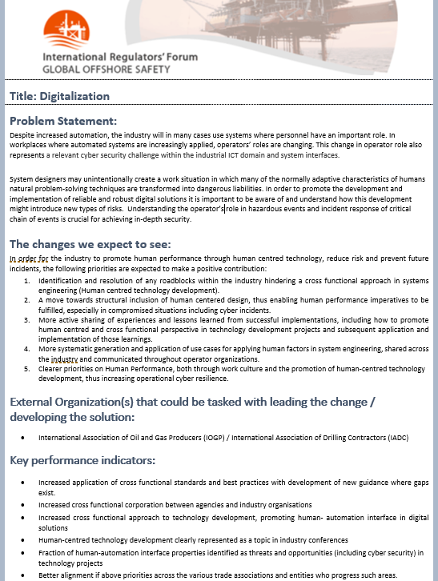
Digitalisation Problem Statement
Problem statement:
Greater emphasis on design that supports human natural abilities when developing and implementing digital and automated systems
Expected outcomes:
Inclusion of human centred design, thus enabling human performance imperatives to be fulfilled
Increased competence and expertise on human centred design of system technology
Active sharing of experiences and lessons learned from successful implementations
Deliverables/KPIs:
Joint IRF/IOGP/IADC implementation
Increased application of cross functional standards and best practices
Increased focus on human- automation interface

Slide 7








Organisation and reporting
IRF working group. Reports to:
  IRF management committee (3 monthly)
  Entire IRF (twice per year)
IADC:
  Nominate committees to engage
  Identify and plan deliverables
IOGP:
  Nominate committees to engage
  Identify and plan deliverables
Other industry bodies and standards organizations to be engaged at a later stage

Slide 8
Schedule
Activities ​ | 2021​ | 2022​ | 2023​
Prepare briefing pack (IRF)*​ Present PS in IRF Mid-year meeting (11.05.21)​ | ​ | ​ | ​
Establish extended IRF work group ​ | ​ | ​ | ​
Regular IRF/IADC/IOGP meetings​ | ​ | ​ | ​
Establish joint IRF/IADC/IOGP comms/outreach​ | ​ | ​ | ​
Decision if any further concrete deliverables are needed and next steps. ​ Execute joint communications plan for aligned message​ Joint IRF work group meetings​ Decide any future work scope ​ | ​ | ​ | ​
Measure implementation result through IRF member audits/verifications​ | ​ | ​ | ​

Slide 9
Digitalisation Problem Statement –
Briefing Pack
September 2021

